Slide 1
Alfresco & Machine Learning: The perfect combination :-)
Cristina Martín Ruiz
CCO @ Venzia IT

Slide 2
What is Alfresco ?

Slide 3


Slide 4
What is “Machine Learning”?
“Ability to learn without being explicitly programmed"

Slide 5
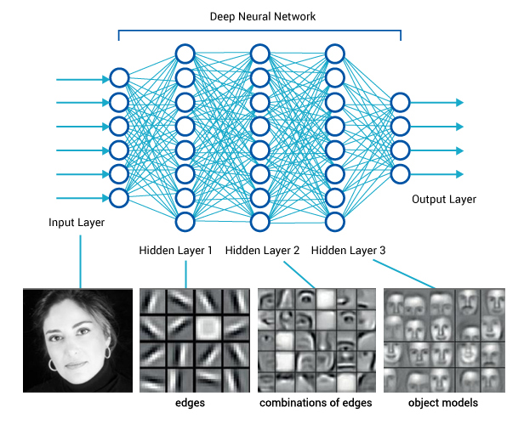
Deep Learning
The new big trend: One step closer to real AI with ML:
Wide
Powerful
Fast

Slide 6
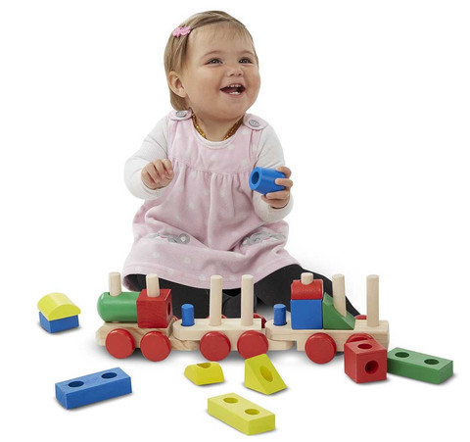
Have fun!

Slide 7
How is working?

Slide 8
Alfresco AMP module : -Image and Video classification custom action and/or behaviour.
Venzia ML Server : -Model based for predict & training. -On top of Caffe framework.
Venzia Video Processing FFServer : -On top of FFmpeg.

Slide 9
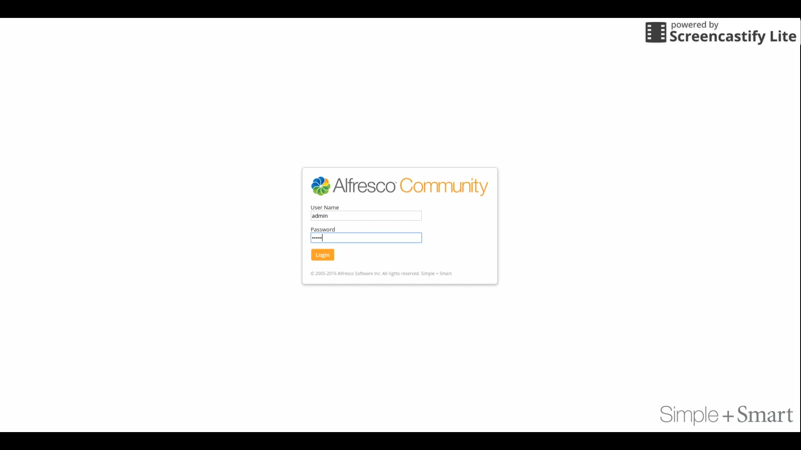

Slide 10

Thank you very much ☺
Cristina Martín Ruiz & Venzia IT Team!!

